Slide 1
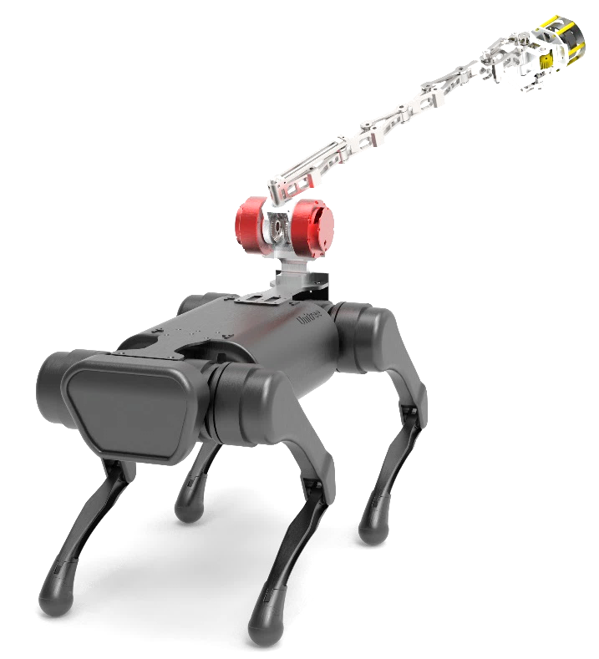
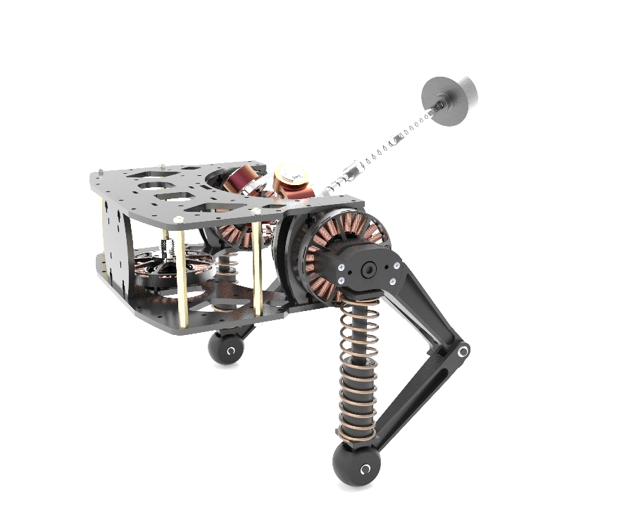
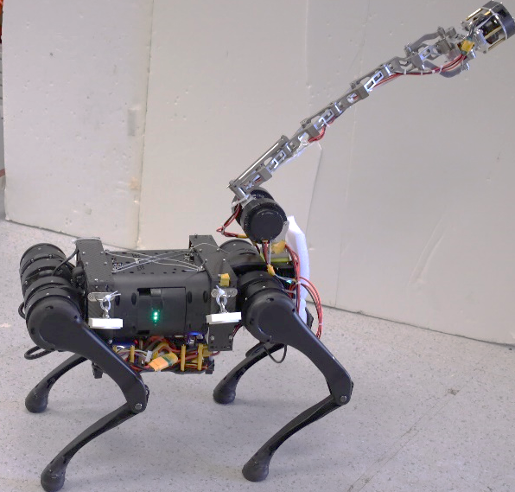
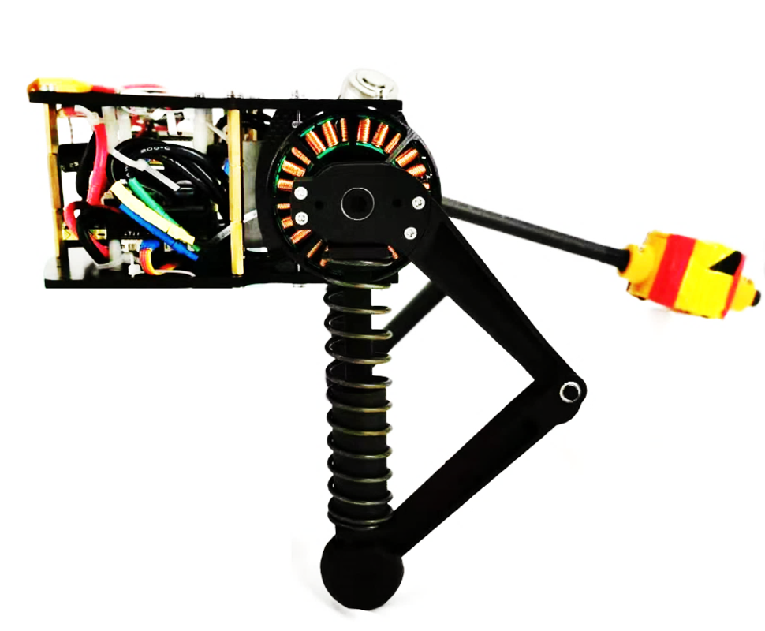

Slide 2
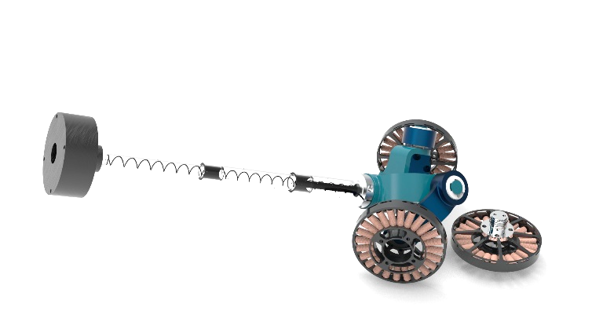
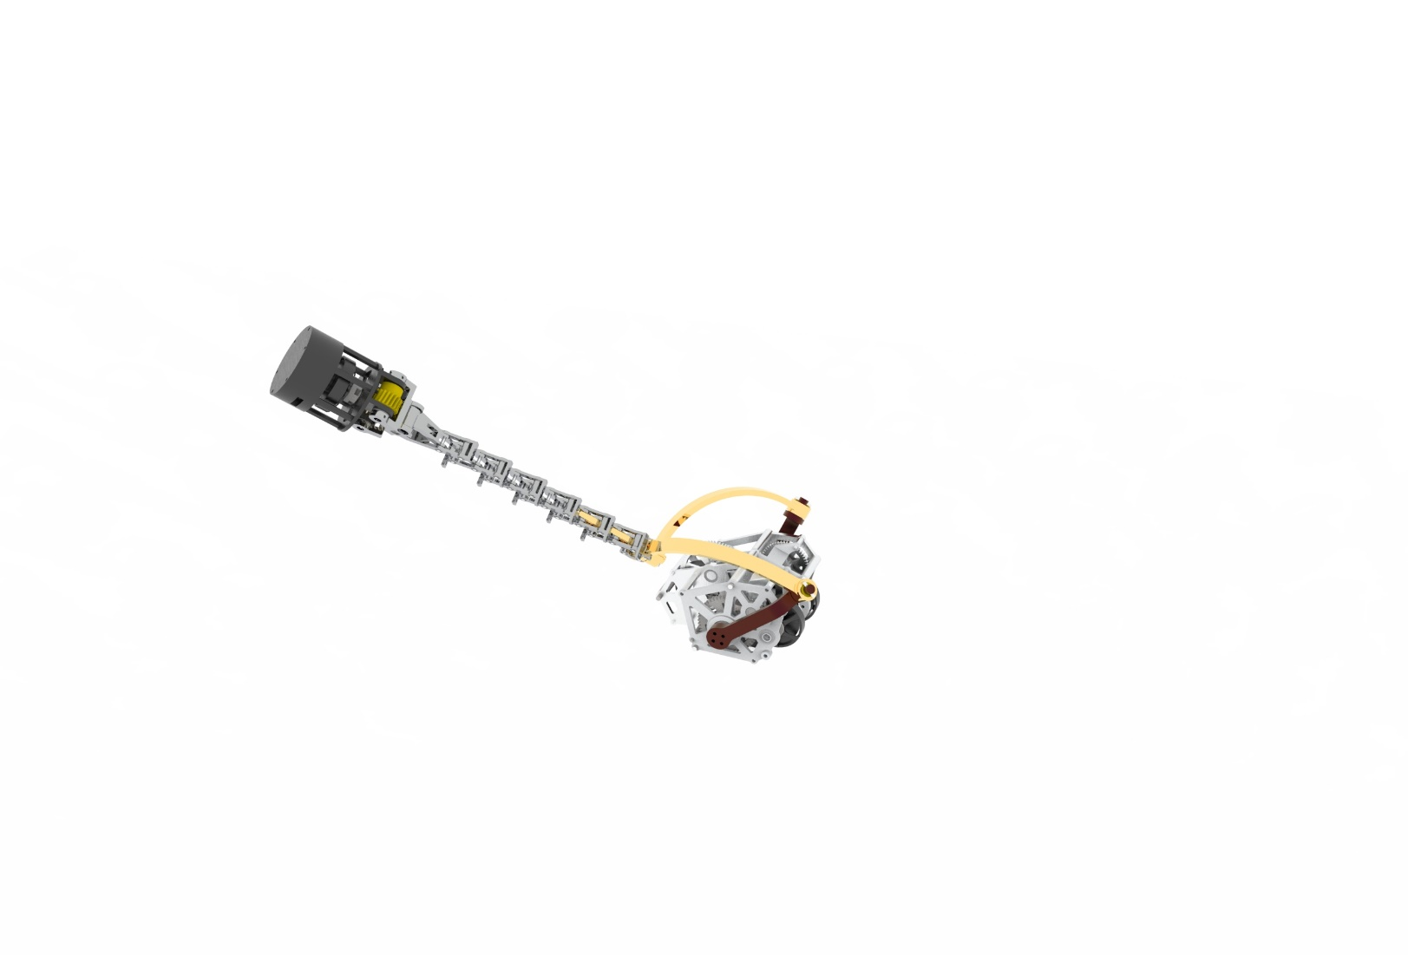
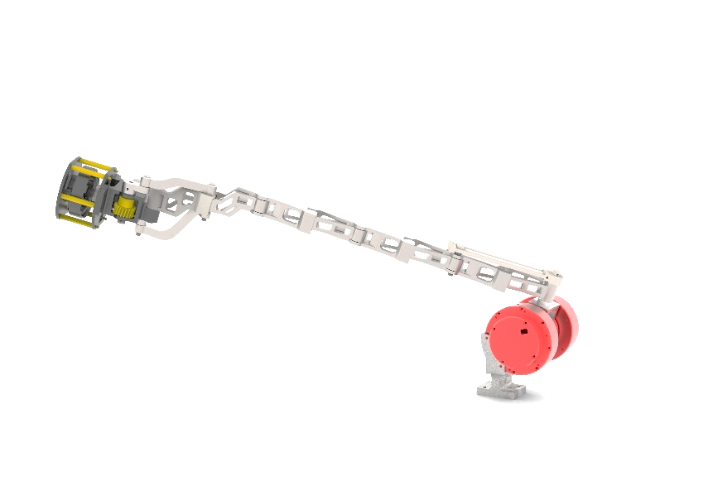
1

Slide 3
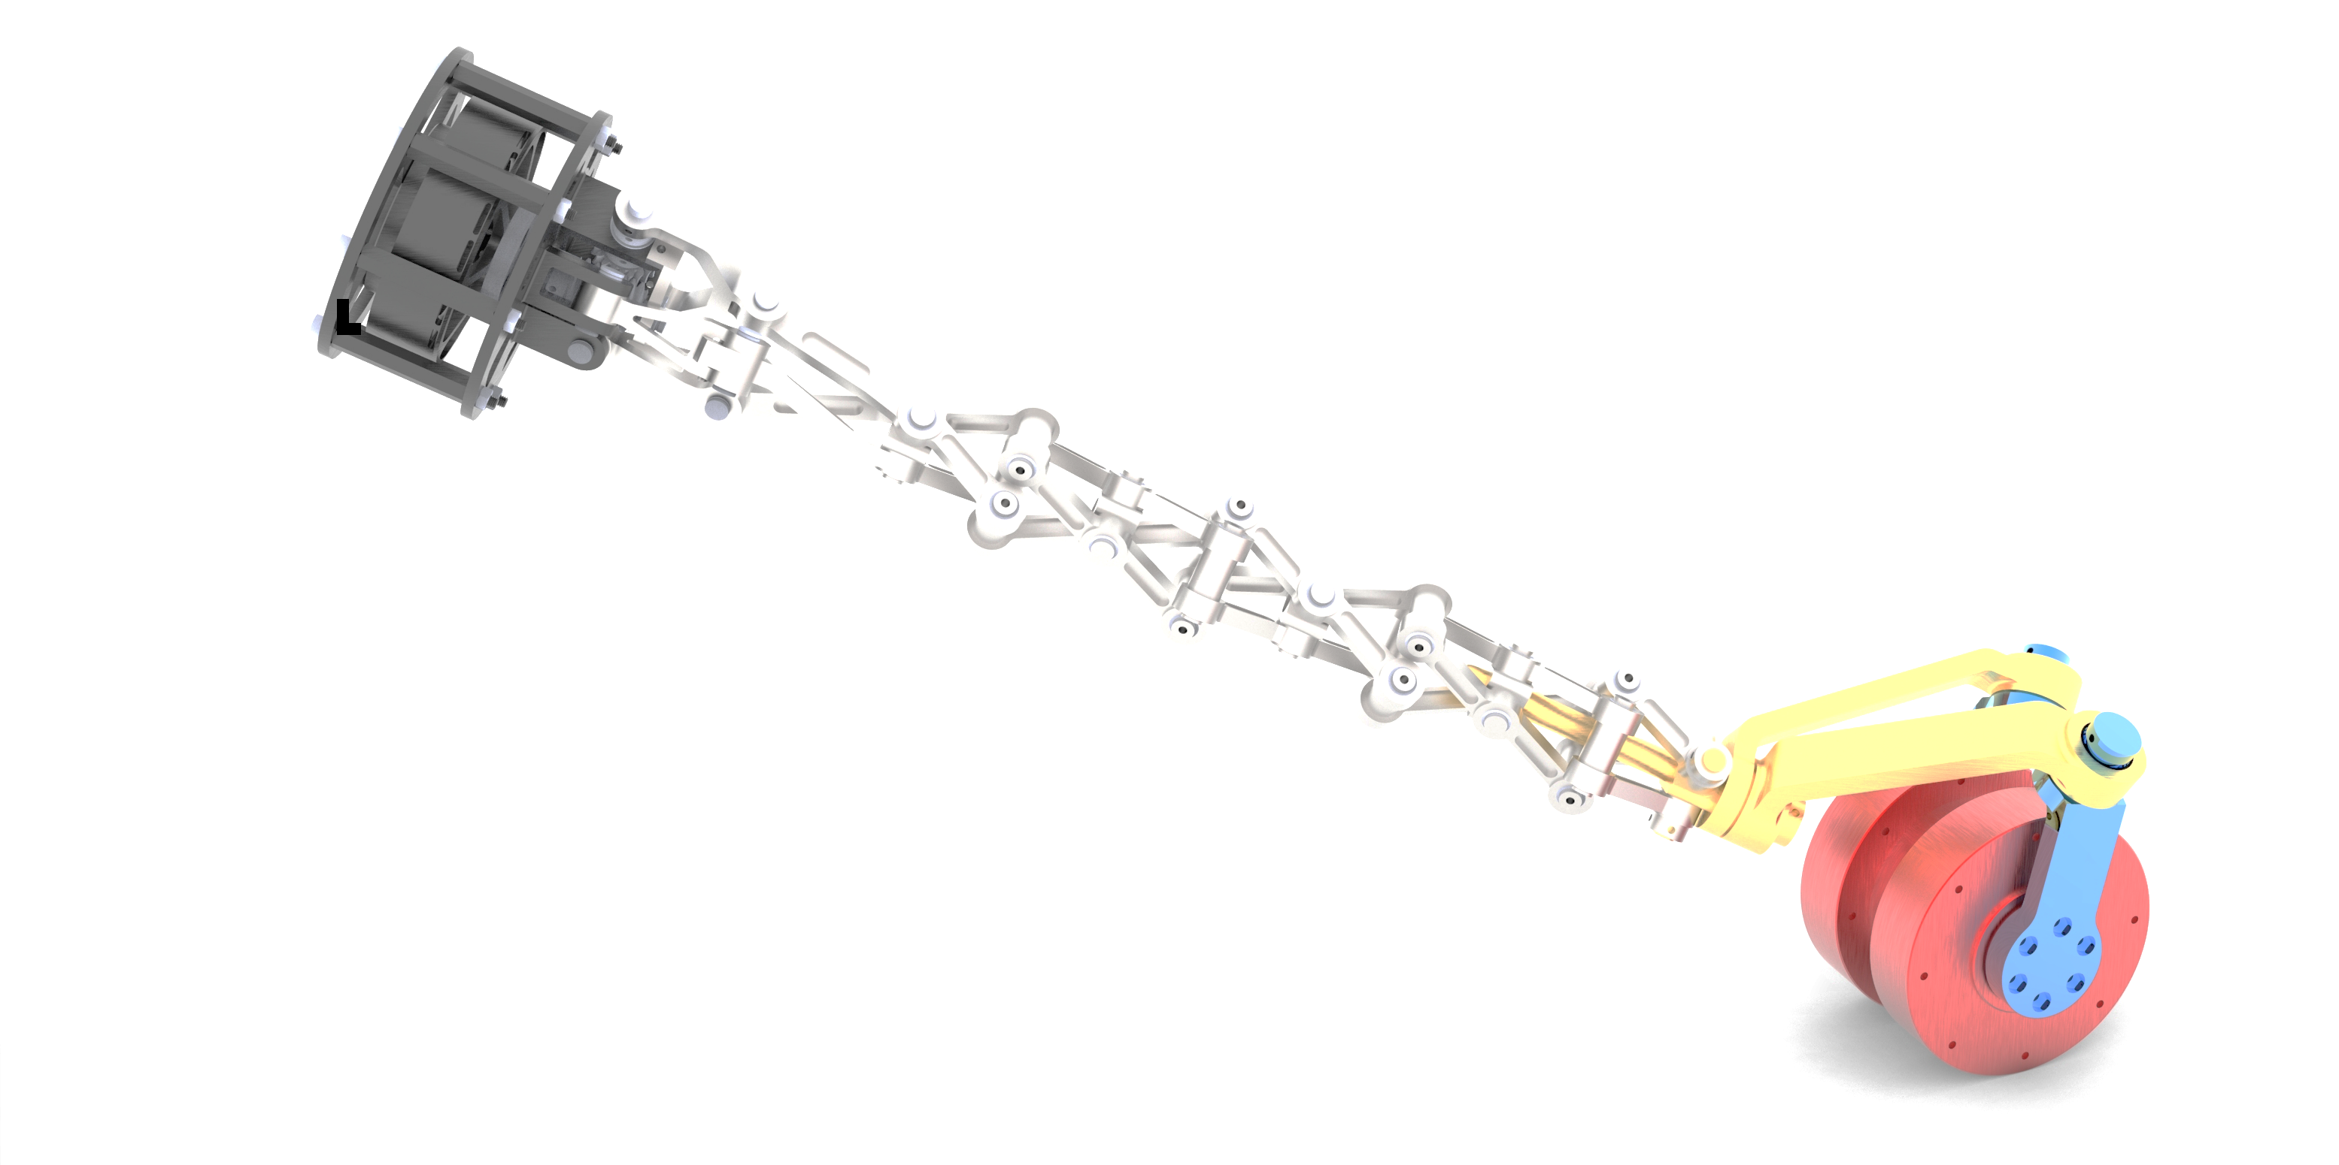
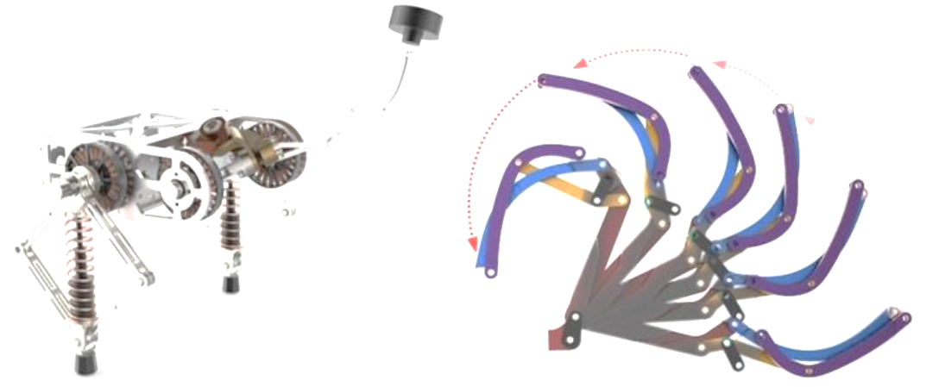

Slide 4
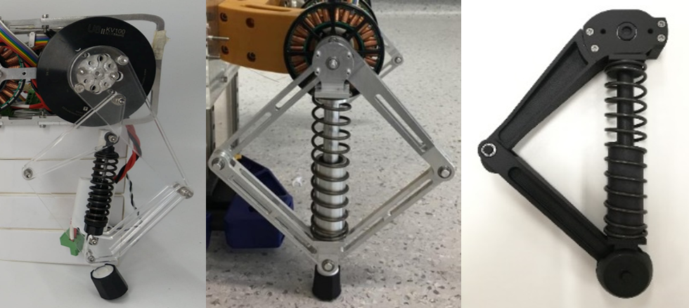
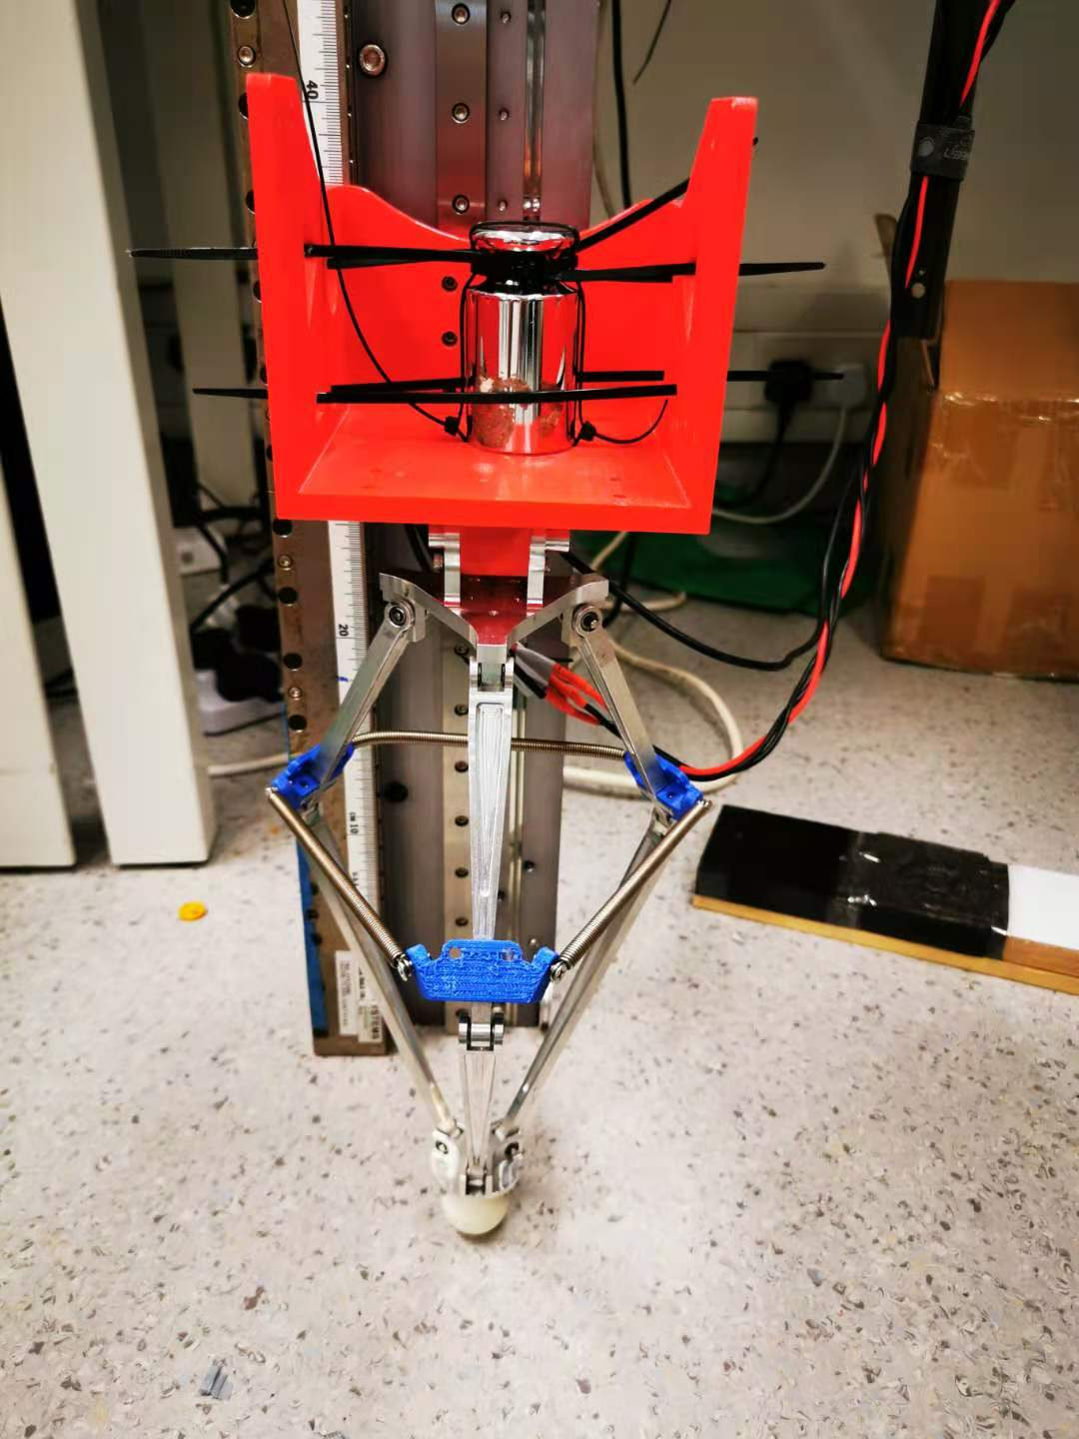
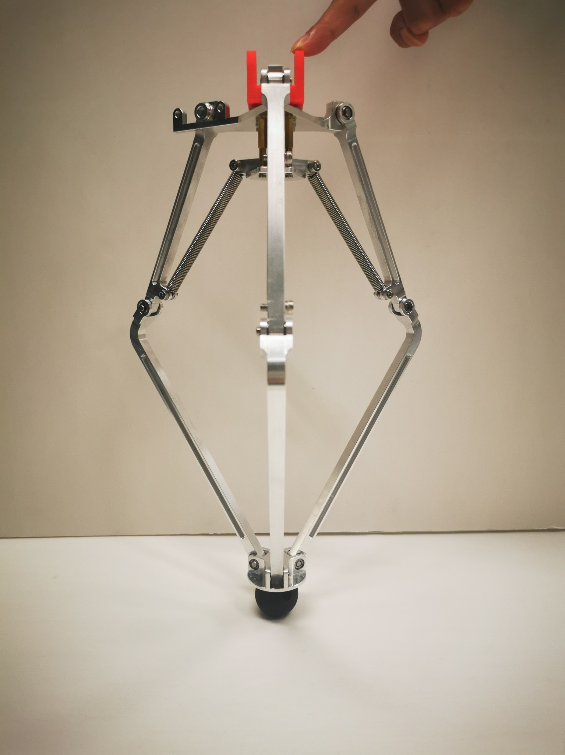
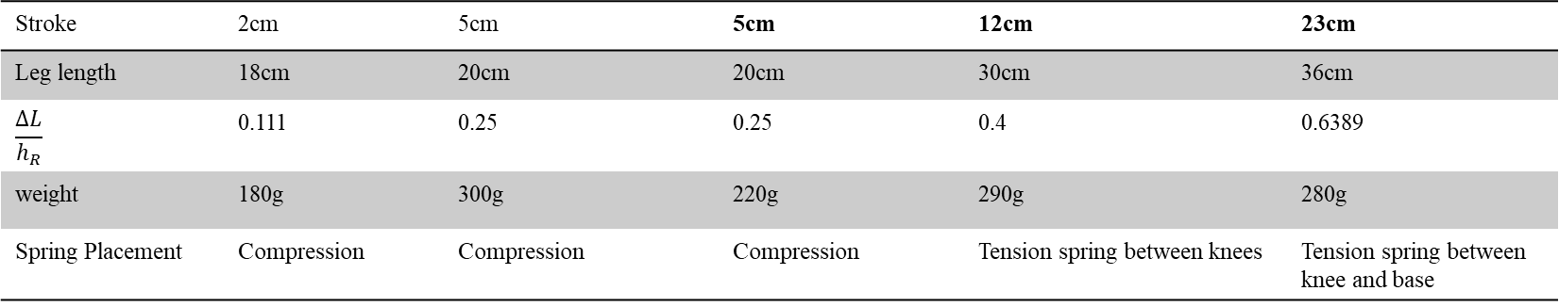
Stroke | 2cm | 5cm | 5cm | 12cm | 23cm
Leg length | 18cm | 20cm | 20cm | 30cm | 36cm
$$\frac{ΔL}{h_{R}}$$ | 0.111 | 0.25 | 0.25 | 0.4 | 0.6389
weight | 180g | 300g | 220g | 290g | 280g
Spring Placement | Compression | Compression | Compression | Tension spring between knees | Tension spring between knee and base

Slide 5
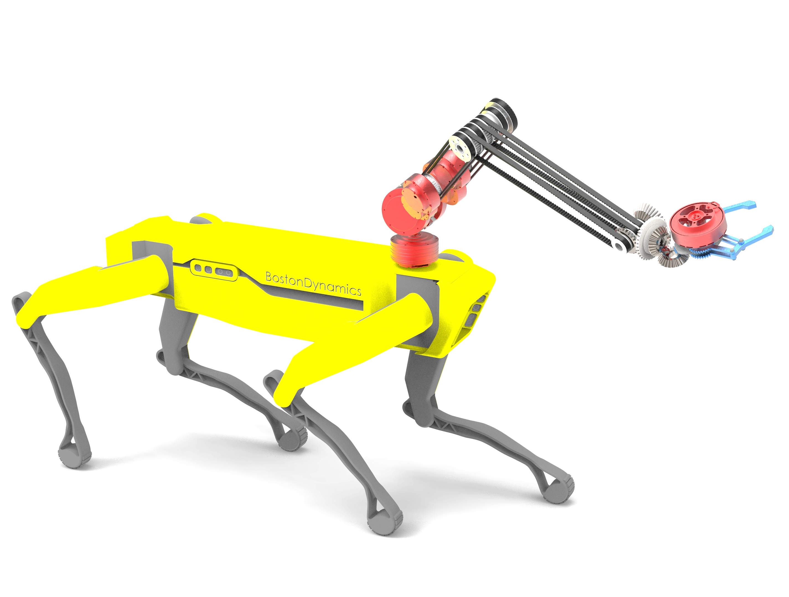

Slide 6
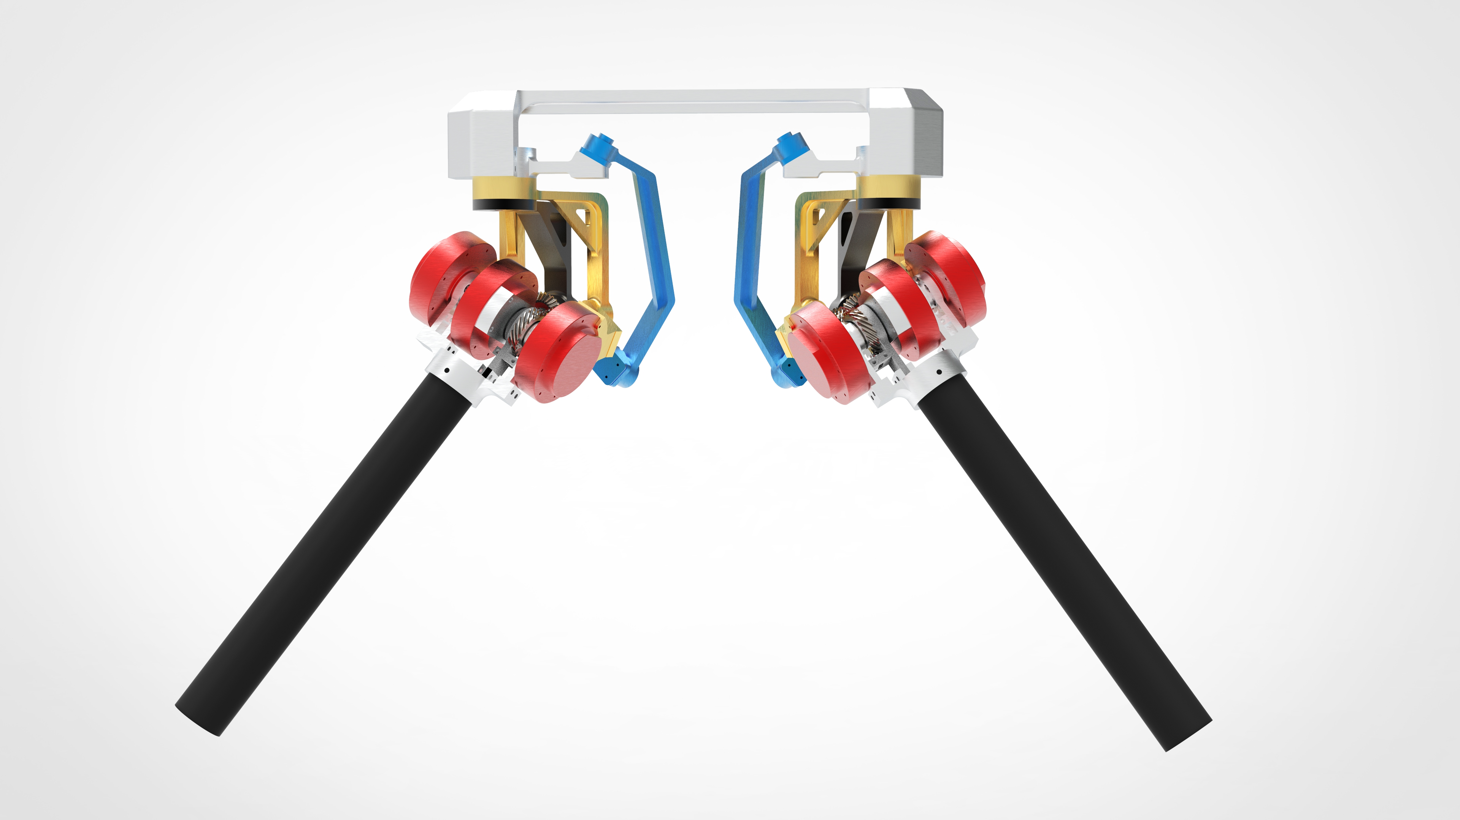
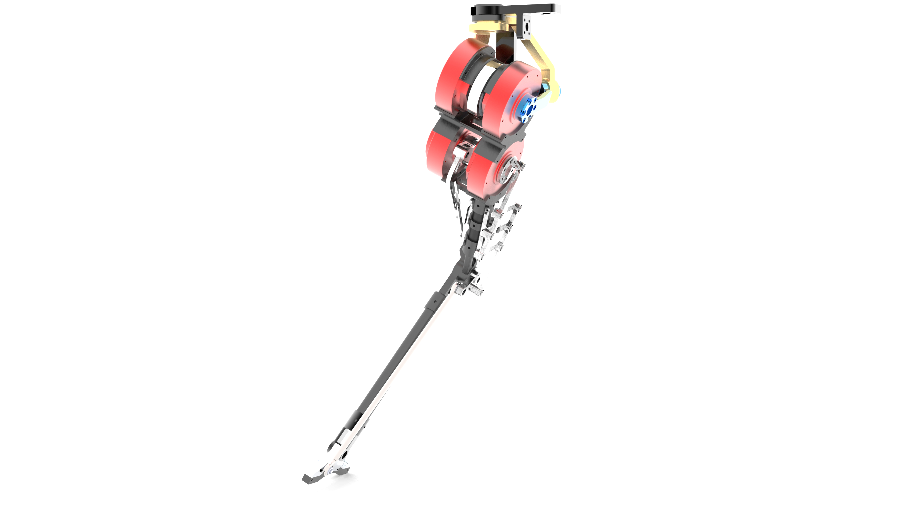
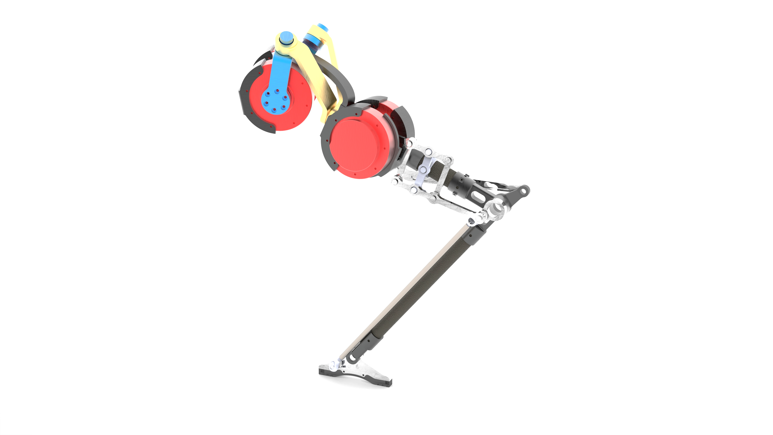
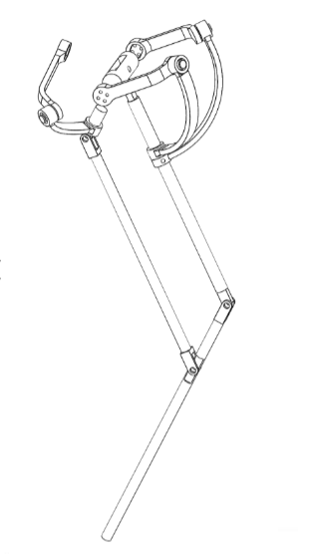

Slide 7
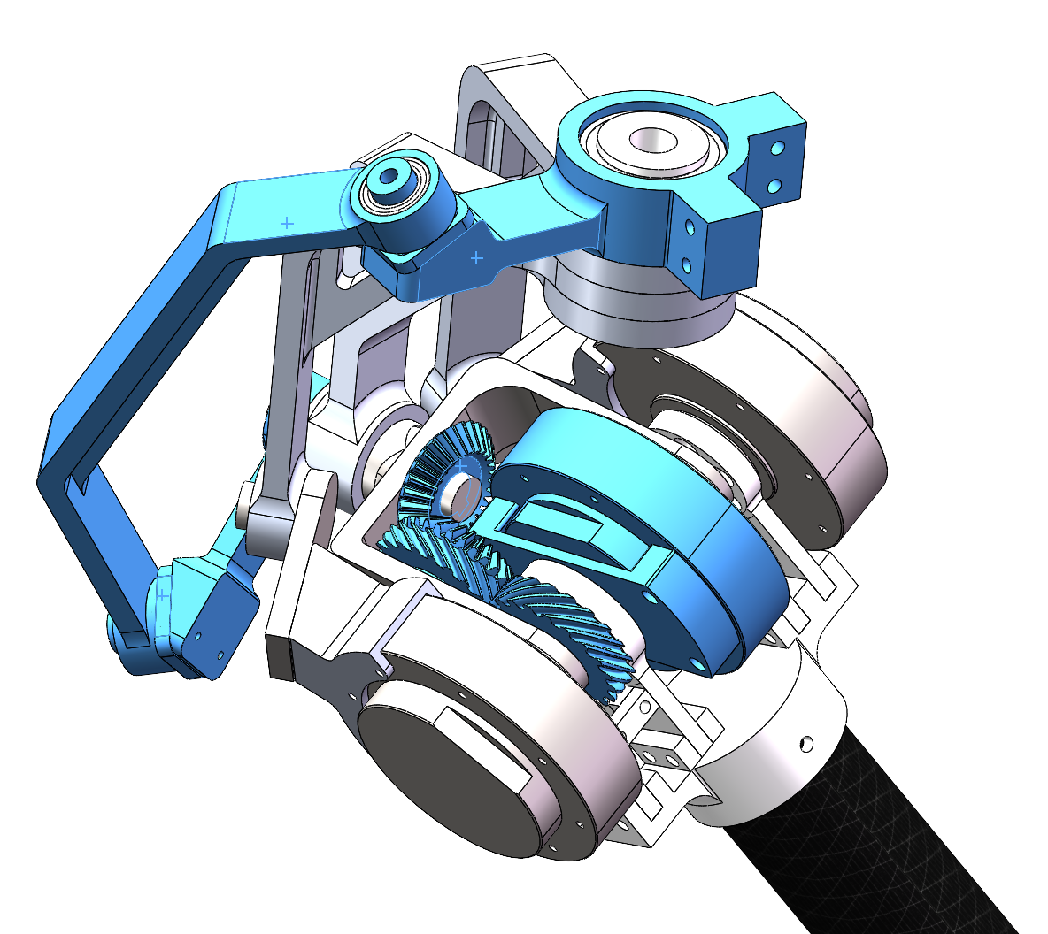
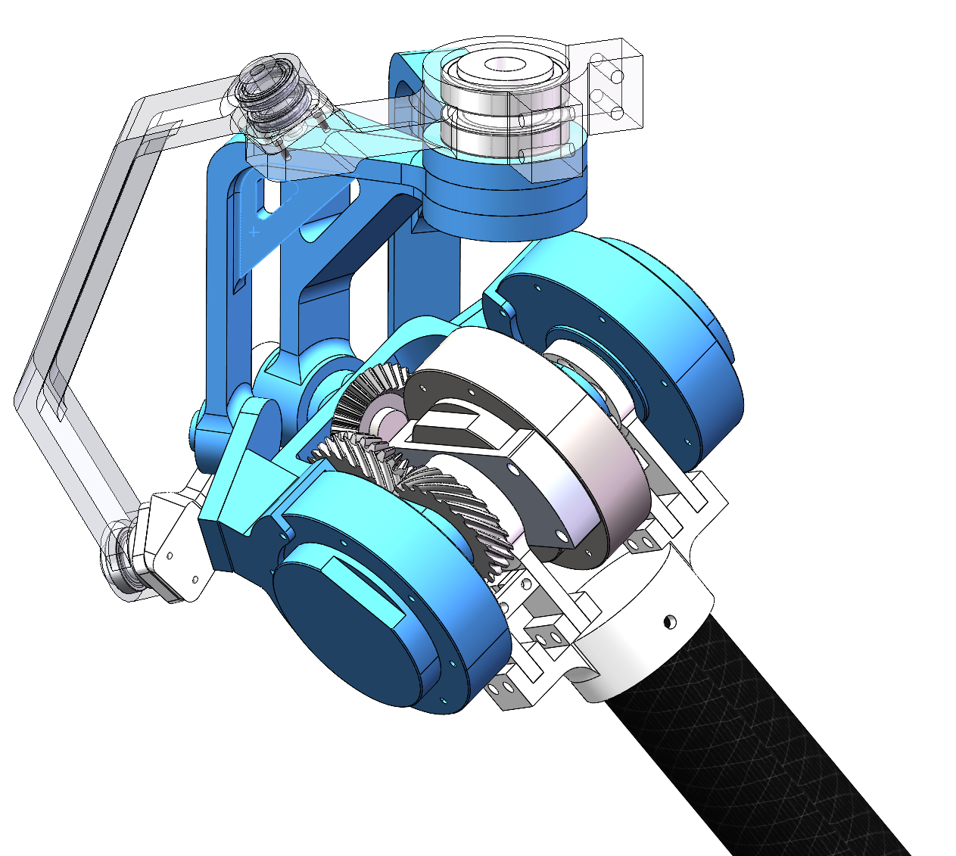
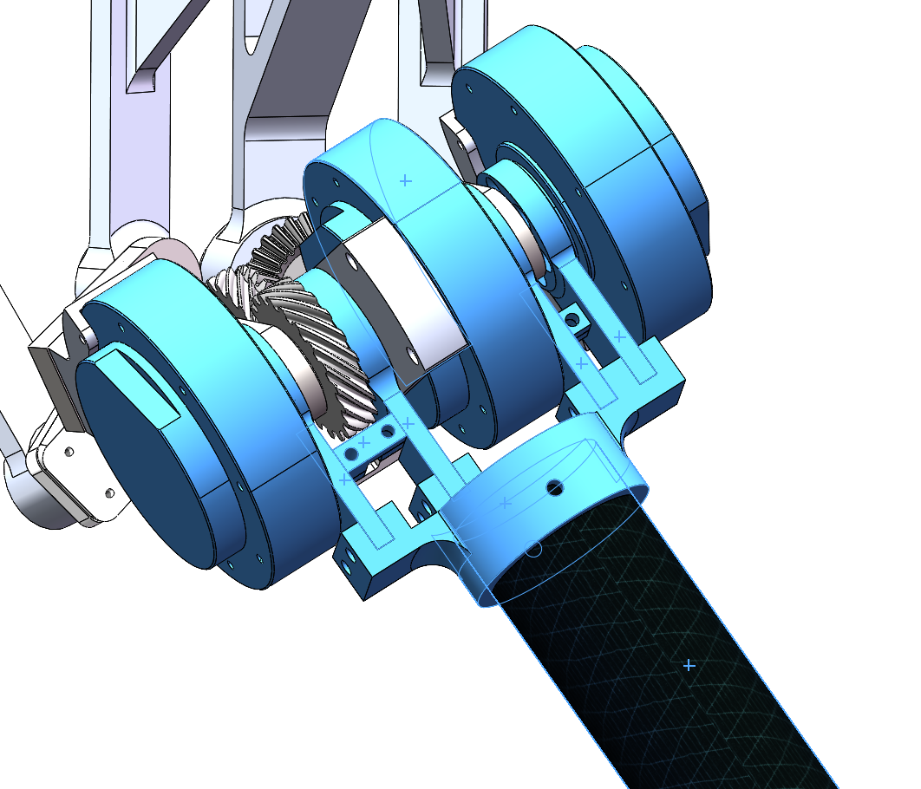
Coupled Double Differential Joint (CDD Joint)
First Differential Joint
Together Fixed Base
Abduction/Adduction DoF
2Motors: Based on SFB(spherical five bar linkage)
Yaw Motion DoF
1 Motor Control: Gear Transmission + 4-spherical-bar-linkage
Flexion/Extension DoF
3 Motors Swing together

Slide 8
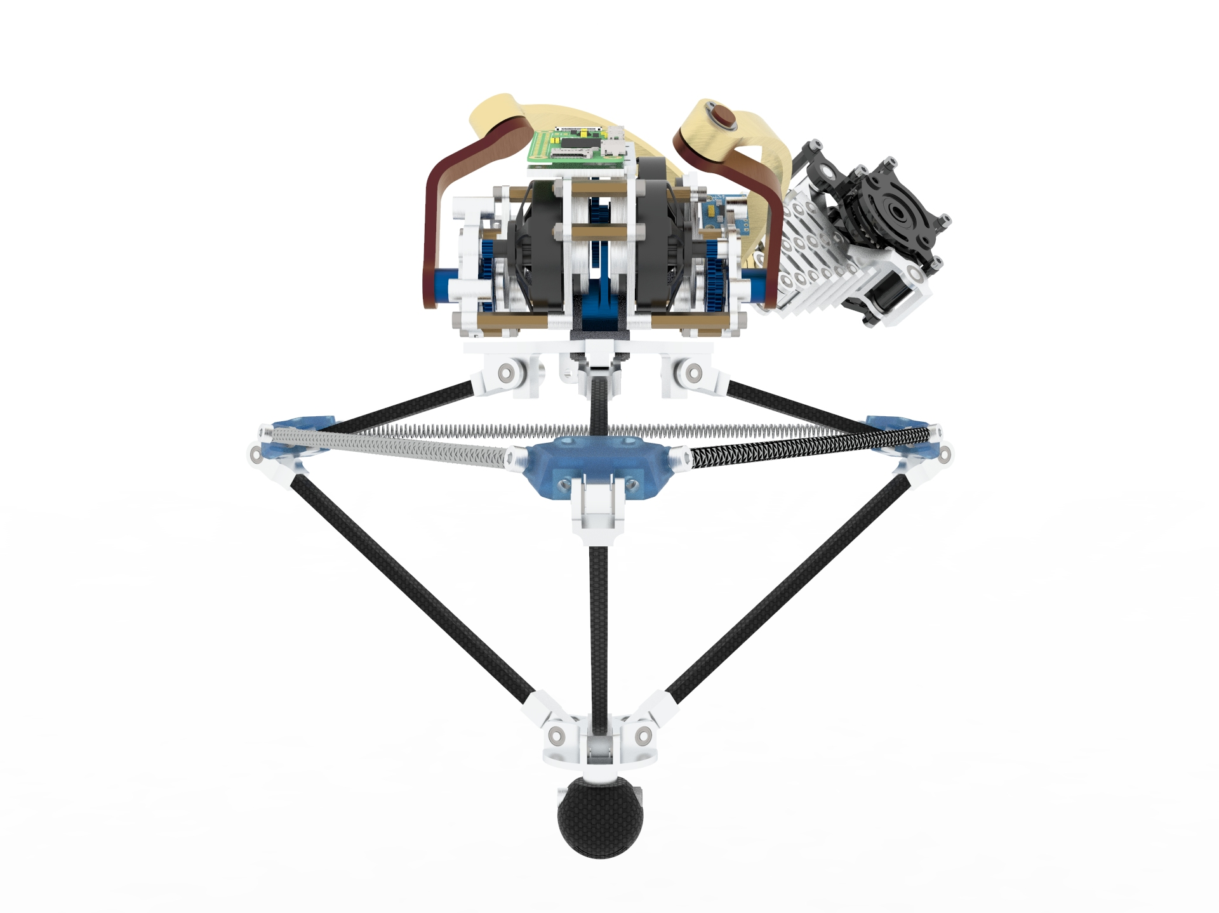

Slide 9
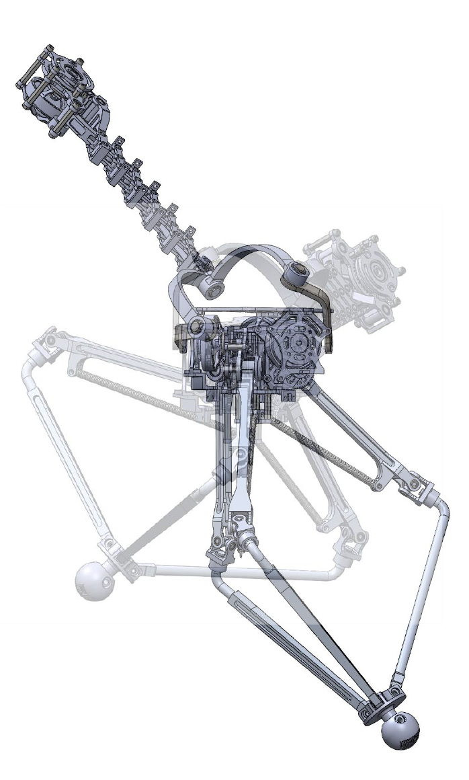
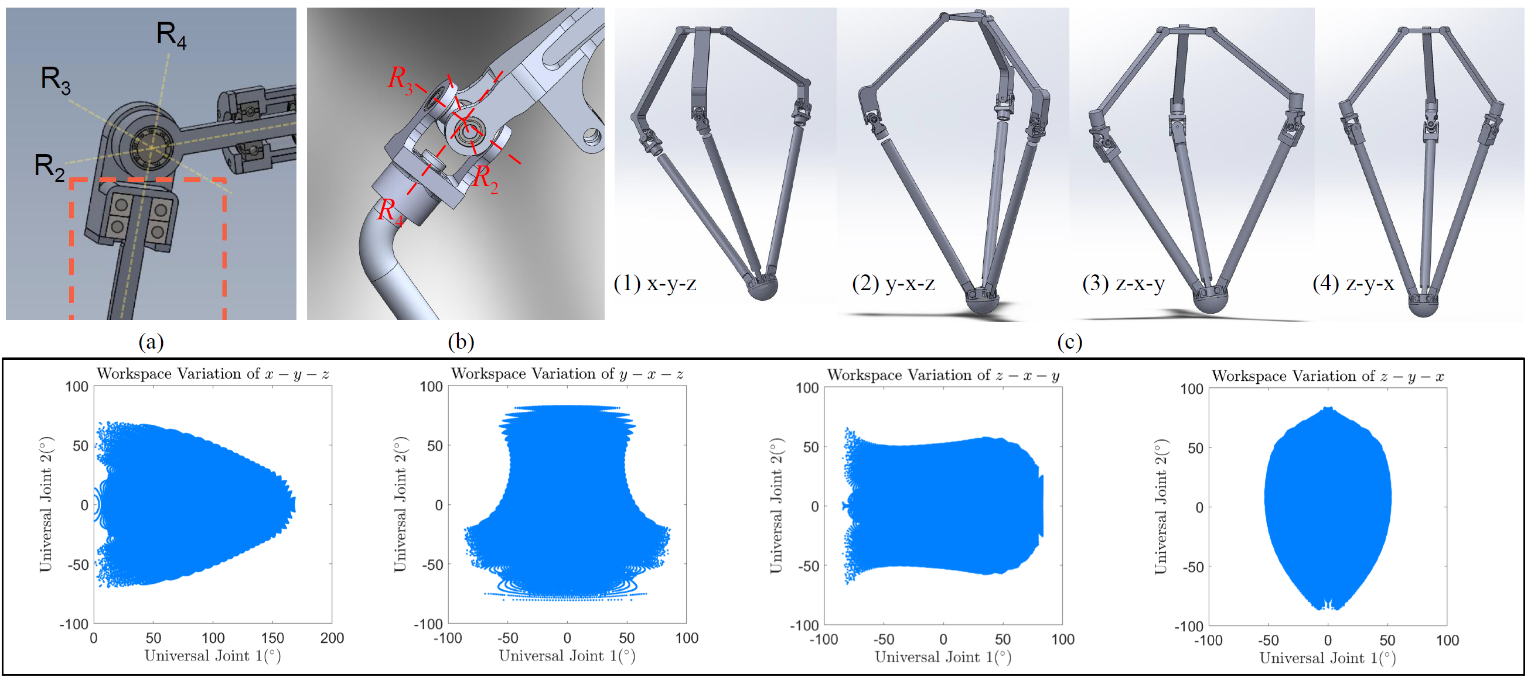
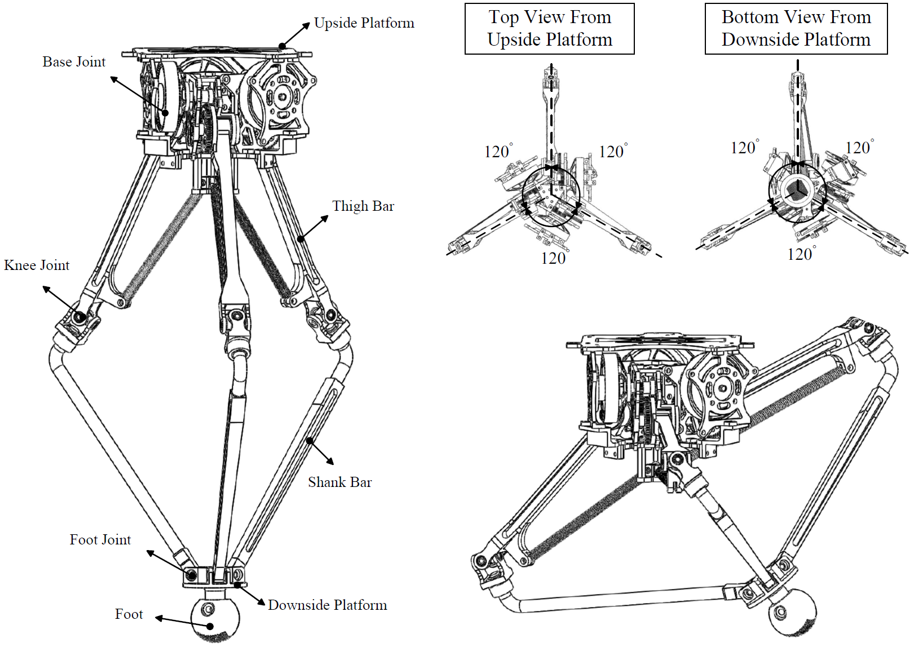
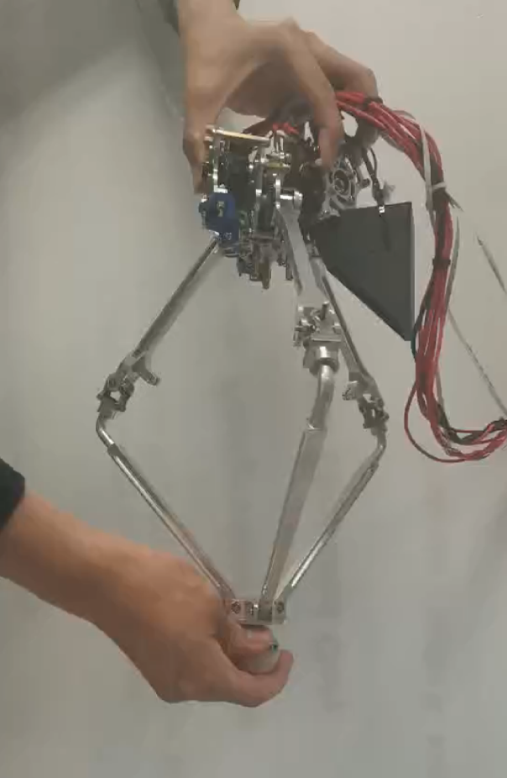
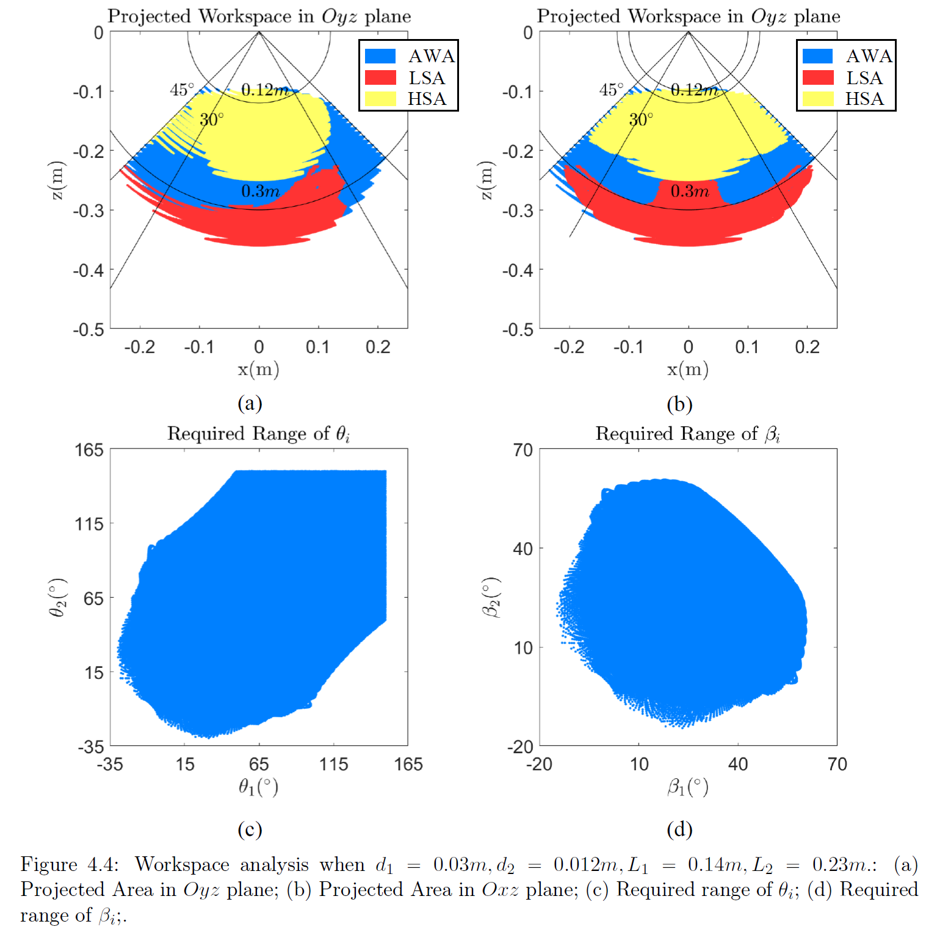
Design Overview
Joint Optimization
Leg Design
Spring Integration Analysis
Initial Prototype

Slide 10
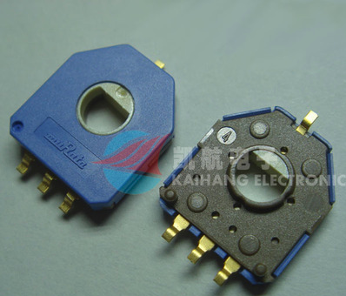
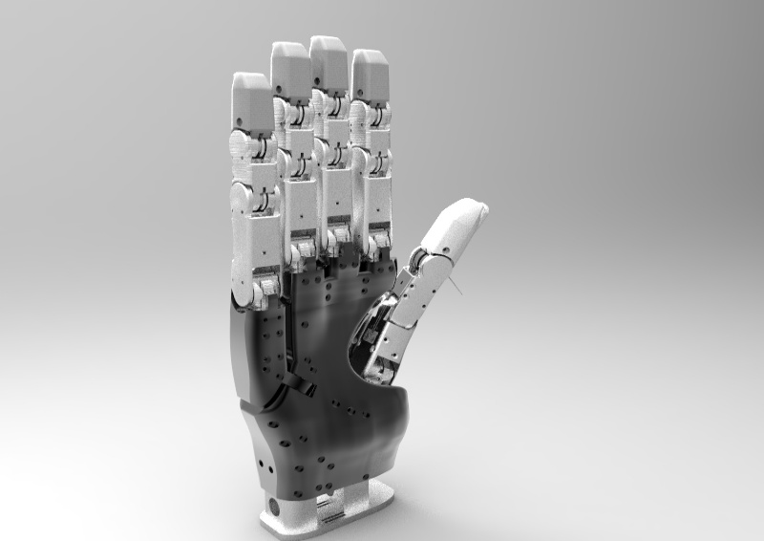
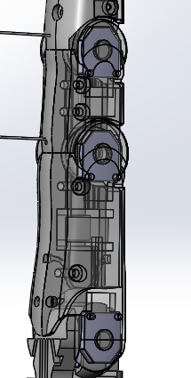
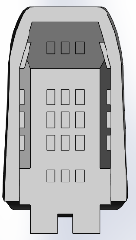
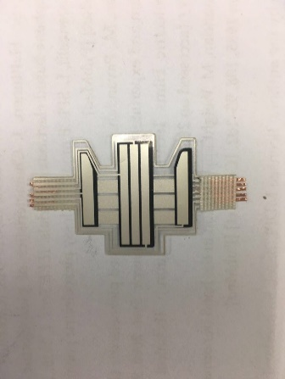
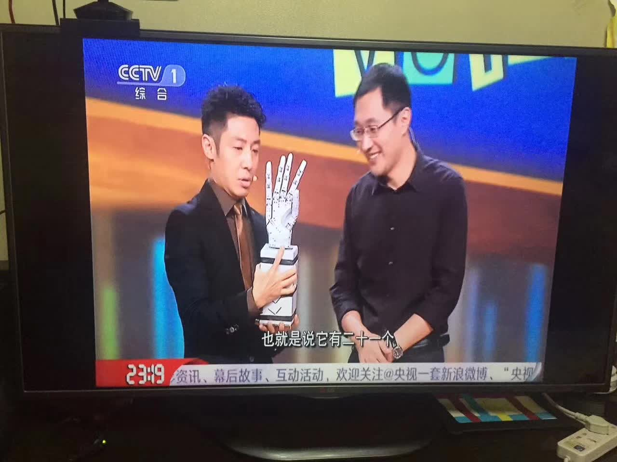
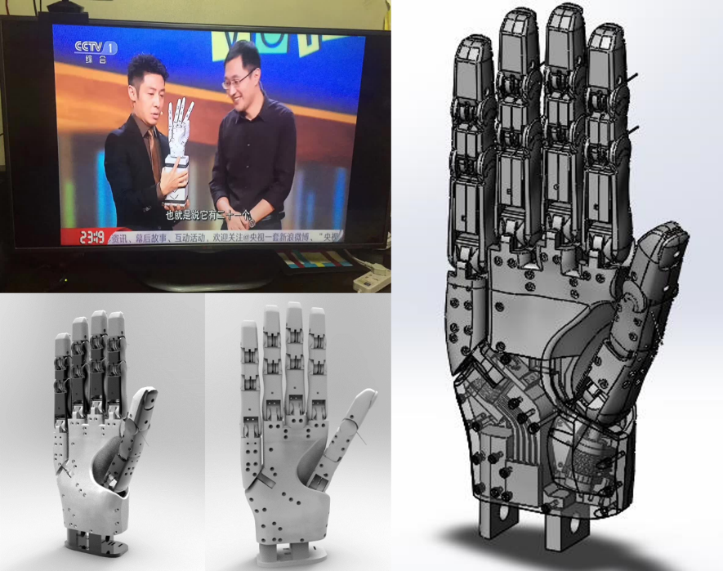
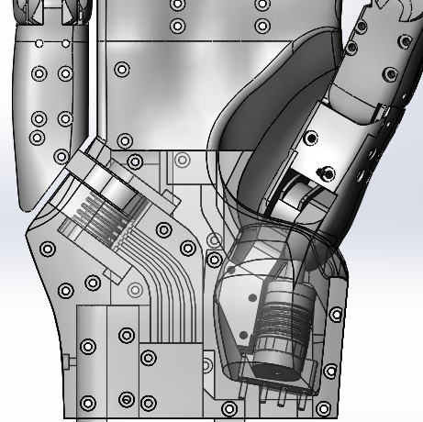
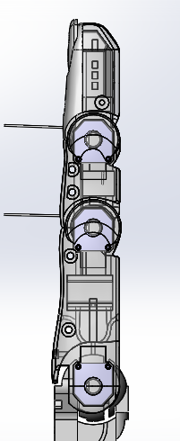
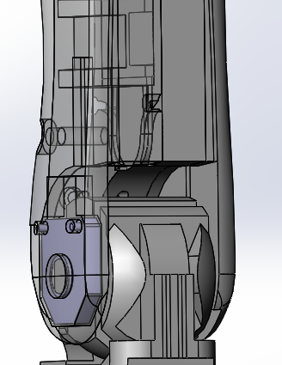
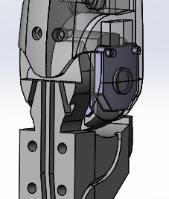
Design Overview
Sensor Integration
Prototype
Design Details

Slide 11
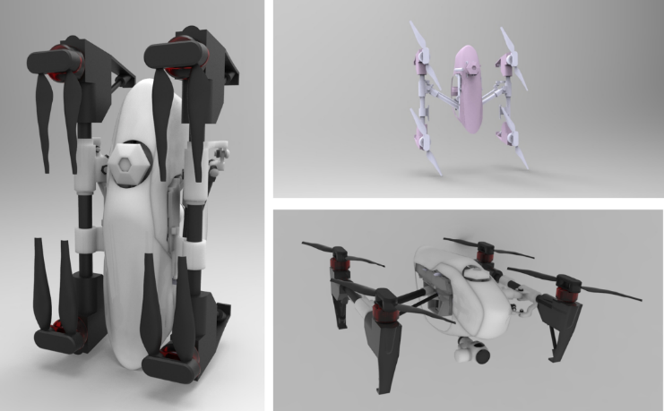

Slide 12
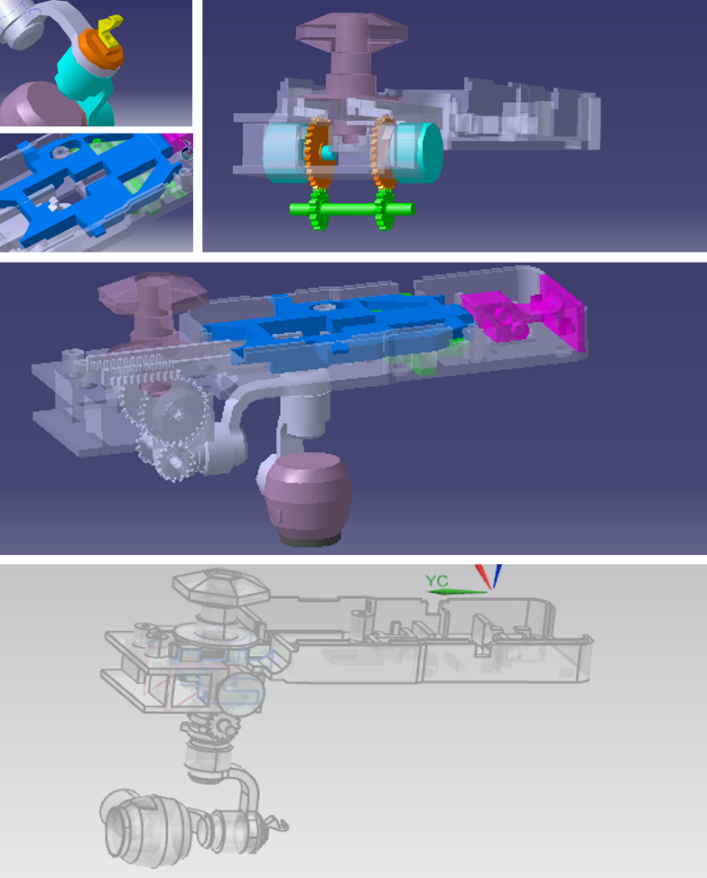
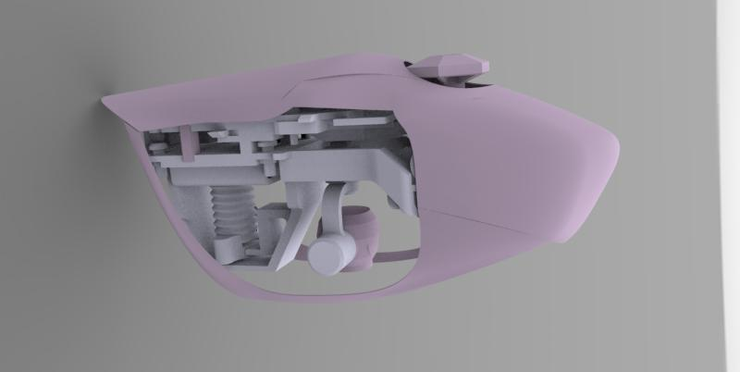
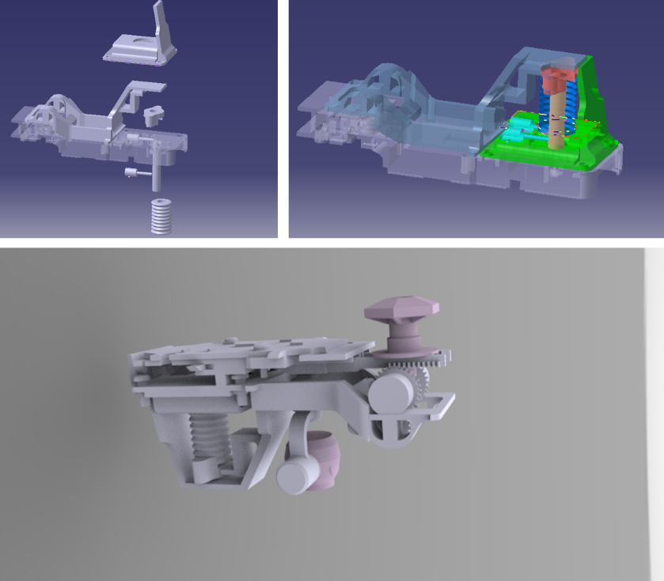
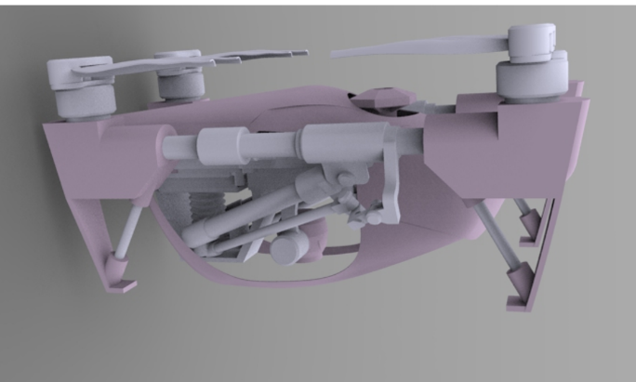
Design Overview
Design Details

Slide 13
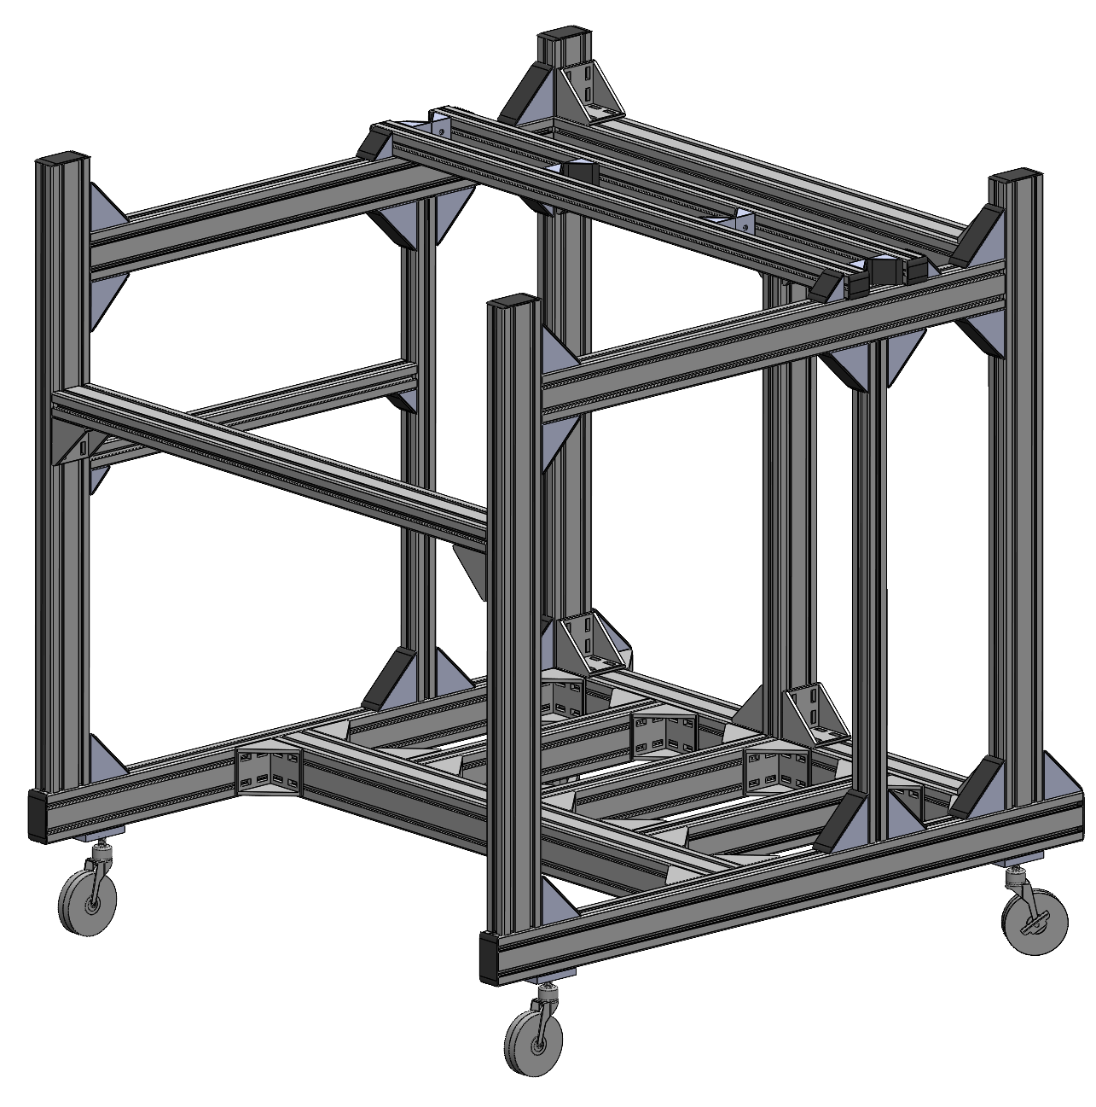
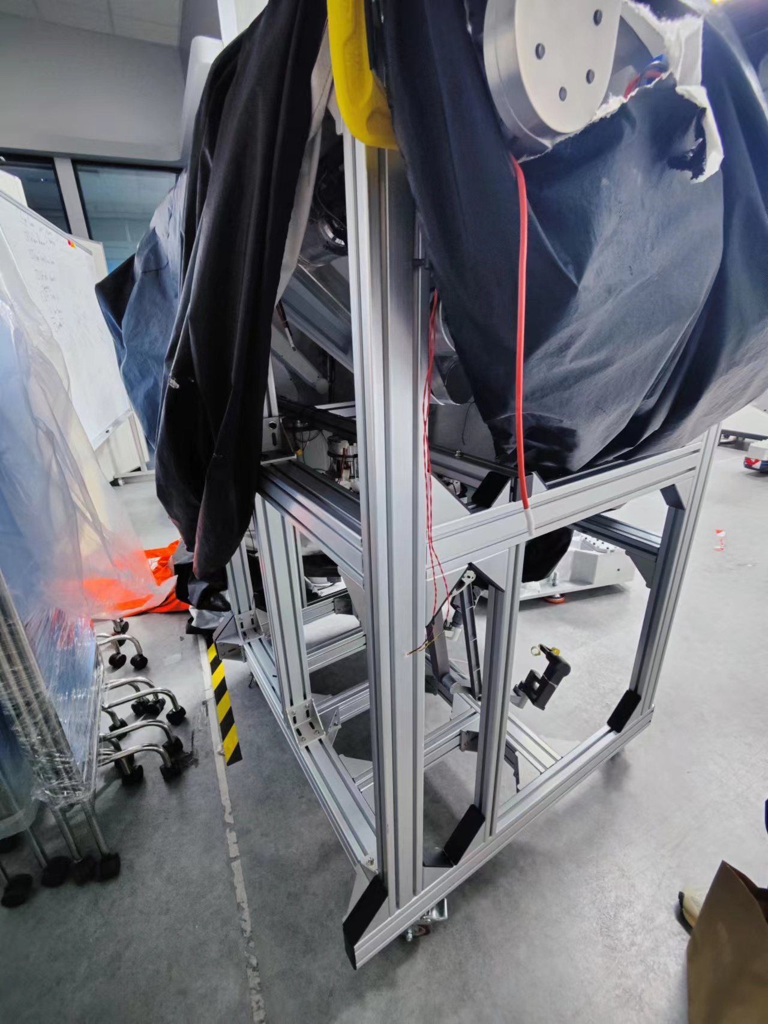
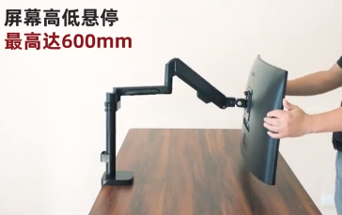
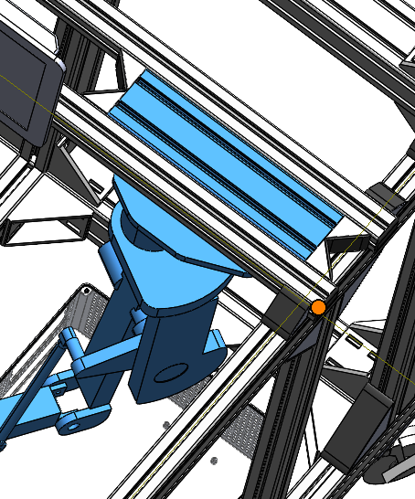
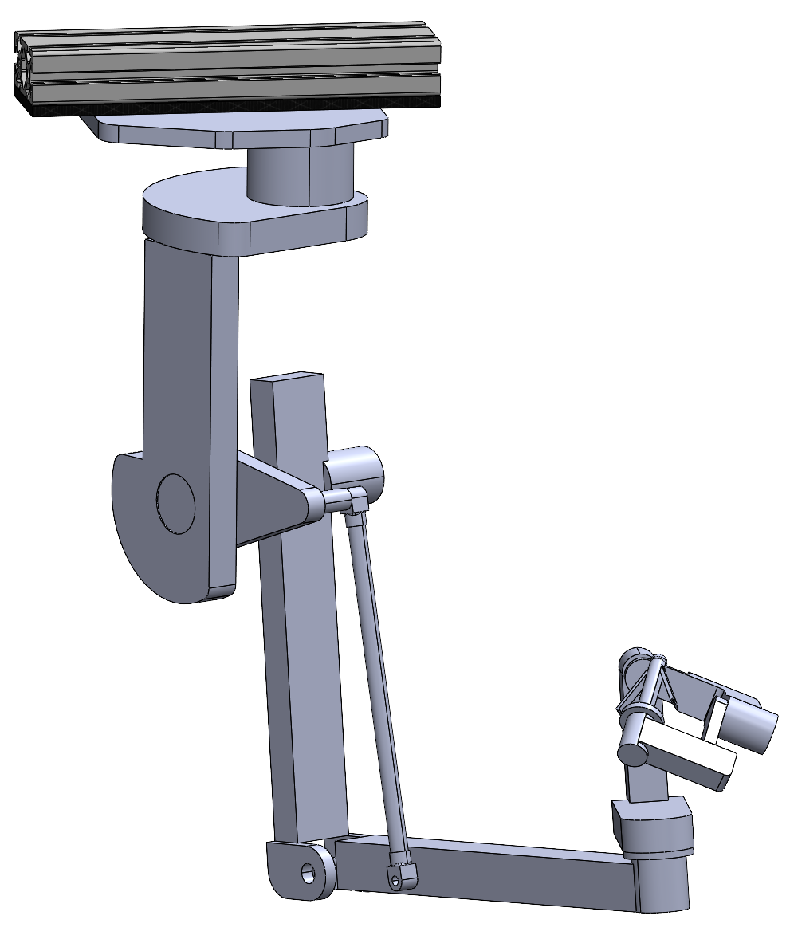
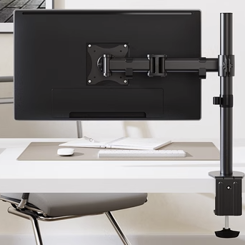
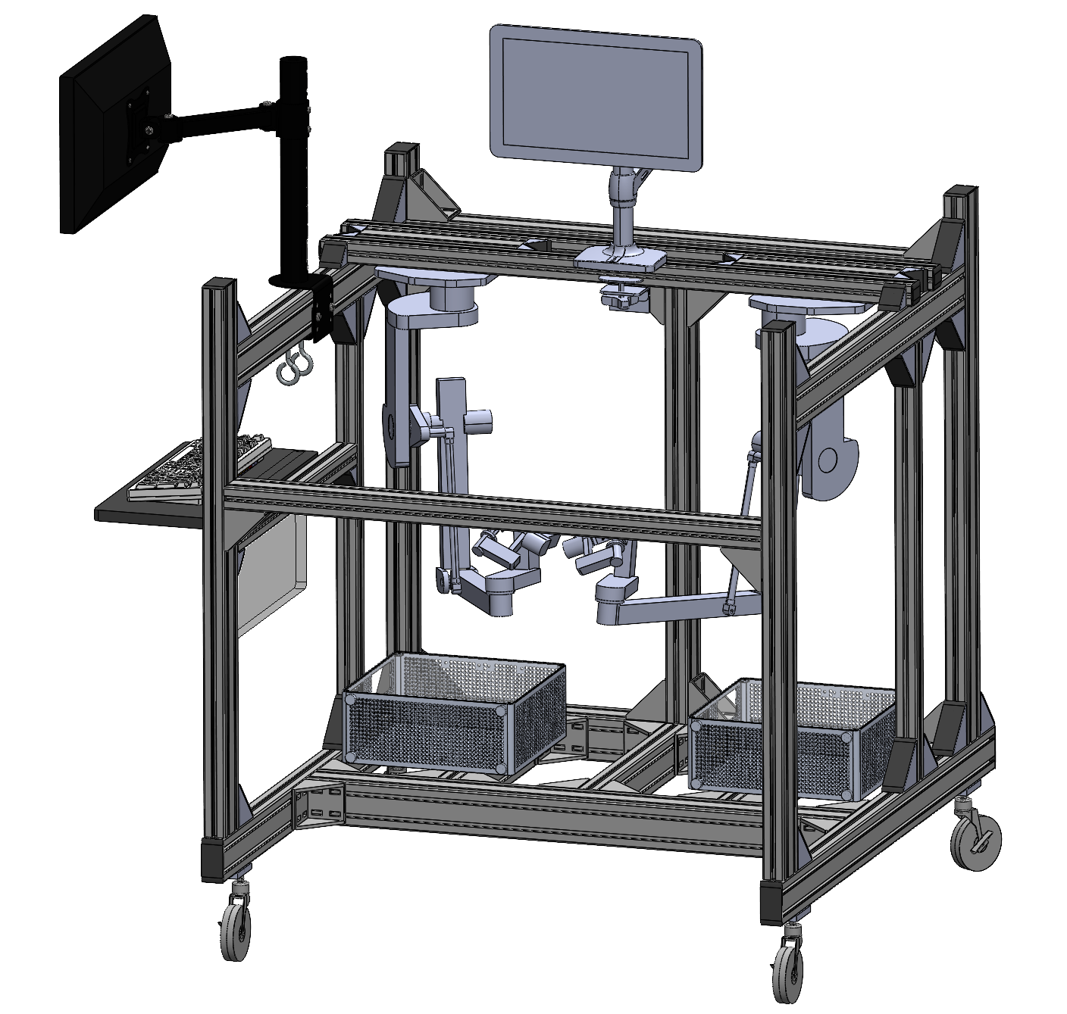



Main Body for Transporting
Connect with the framing structure for easy mounting.
Monitor Arm 1
Master Arm
Monitor Arm 2
医用万向推车轮子
(first choice)
铝型材专用福马脚轮 (backup choice, for undertaking larger forces and being more stable)
Keyboard Placer
Overview
Wheel

Slide 14

Design Overview
Prototype

Slide 15


Slide 16





Design Overview
Design Details
Tail Usages:
Balance
Adjust the walking directions
Telescopic tail can help multiple adjustment
Background
Target Motions:
Pipe or even Rope walking
Plain ground walking
Waling between 2 pipes ,walking over a hole, walking inner the pipes.

Slide 17



A
B

Slide 18






Design Overview
Design Details
A
B
Background

Slide 19


Slide 20







Design Overview
Stair Climbing
Grasping structure design
1
2
Grasping structure design
Grasping
3
4
1
2
3

Slide 21
Design Overview
Stair Climbing
Grasping structure design
1
2
Grasping structure design
Grasping
3
4
1
2
3

Slide 22



Slide 24



Robot Design
Field Introduction
Container Design
Container
Actual Field

Slide 25


Slide 26
Actual Field
Robot Components
Field Details
Robot Car

Slide 27


Slide 28
Competition Introduction
Field Object Recognition
Robot Recognition
Self Recognition

Slide 29


Slide 30


Slide 31
Competition Overview
Robot Grasping Motion
Task Operation
Visual Processing

